Slide 1
SDSC 2005 - Introduction to Computational Social Science (Lecture 8)
Hao PENG
(haopeng@cityu.edu.hk)
Department of Data Science
City University of Hong Kong
https://haoopeng.github.io/

Slide 2
Agenda today
Overview of Causal Inference
Coarsened Exact Matching (CEM)
Propensity Score Matching (PSM)
Difference-in-Differences (DiD)
Mediation Analysis
Conclusion and Applications
This lecture focuses on practical methods for estimating and quantifying causal effects in observational data.

Slide 3
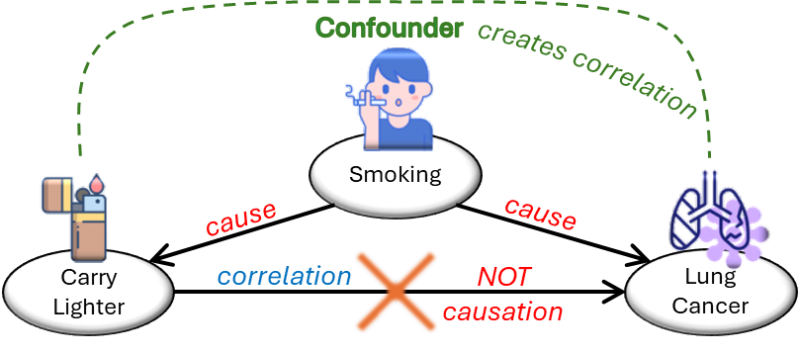
What is Causal Inference?
Goal: Testing and quantifying the causal effect of one variable (treatment) on an outcome variable, beyond correlation.
Challenges in observational data: Confounding
Key methods: matching, difference-in-difference, mediation
Counterfactuals – what would happen without treatment?
Key Assumption: no unmeasured confounders.
Credit: https://medium.com/data-science-at-microsoft/
Notes:
In experimental data, the treatment and control groups are often balanced, but are imbalanced in obs data.

Slide 4
Applications of causal analysis
Healthcare: Determining which treatments improve patient outcomes.
Economics: Assessing the effect of economic policies on employment.
Education: Evaluating the effect of learning tools on performance.
Marketing: Measuring the impact of marketing campaigns on sales.
Environmental policy: Assessing the impact of implementing pollution control measures on outdoor air quality.
Science policy: Examining the impact of GenAI on paper quality.
…
Running experiment is unethical or unrealistic in many cases.

Slide 5
Daily causal questions
Does drinking coffee improve work performance?
Does regular exercise lead to better sleep?
Does class attendance improve final grade?
How much does the new icon increase user engagement?
Does gender/age/ethnicity impact admission acceptance?
…
Can “WE” words increase the perceived paper quality?
Other examples?
Notes:
What factors are driving customer churn?
How can we boost user engagement on our platform?

Slide 6
Why these methods?
Observational data can suffer from two issues:
Data imbalance across groups in IV (or skewed continuous IV).
Lack randomization to balance confounds across groups (unlike RCTs).
Matching methods can help to balance covariates between the treatment group and the control group:
Coarsened Exact Matching (CEM)
Propensity Score Matching (PSM)
DiD: Accounts for temporal and group self-differences.
Mediation analysis: Unpack mechanisms behind causal effects.
Psychological factors
Cognitive factors
Behavioral factors
Notes:
For the first issue, the found correlation may be purely driven by samples selection bias in the minority category (e.g., only a few Women are observed in the data and they happen to have low acceptance).

Slide 7
Coarsened exact matching (CEM)
A non-parametric method to reduce imbalance in covariates.
Three steps:
"Coarsen" continuous variables into bins
e.g., age: 18-30, 31-50, etc.
Categorical vars remain the same.
Do exact matches on coarsened variables
1-to-1 or 1-to-many
Discard unmatched units
Results in matched samples with identical distributions
Compare the average DV across two matched groups
Notes:
Often use matching without replacement in CEM.

Slide 8
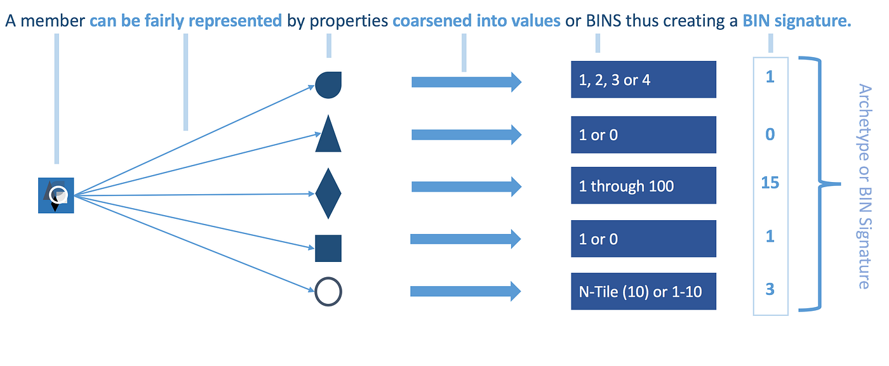
Coarsened exact matching (CEM)
CEM logic is quite straightforward as it requires no statistical modeling for matching/pruning (a.k.a., non-parametric).
Notes:
Often use matching without replacement in CEM.

Slide 9
CEM Example
Question: The effect of LLM usage on students’ course grade?
What’s the treatment?
Covariates: gender, major, track, age, prior GPA, ethnicity
What else should we match on?
How do we coarsen each variable?
Trials and iterations are often needed.
Result: Matched sample shows a 0.7 boost in GPA.
Empirical evidence from last year’s data.
Notes:
Course code? Students should also be matched on the same class.

Slide 10
CEM in practice
Q: Do retracted papers receive more online attention?
Covariates used in matching:
Year, Journal
Team size, Author citation percentile
https://www.pnas.org/doi/10.1073/pnas.2119086119
Notes:
Scientific misinformation

Slide 11
CEM (dis)advantages
Advantages:
Easy to understand and implement (e.g., R package 'cem’).
Compare to PSM: CEM is more transparent, less model-dependent.
Limitations:
Data loss from pruning.
Assumes that coarsening fully captures confounders.
Coarsening level: trades offs between sample size and accuracy – coarser means more matches, but at the cost of quality (biased estimation of ATE).

Slide 12
Propensity Score Matching (PSM)
PSM: Match units based on probability of treatment.
Propensity score: P(T=1 | X) estimated via a logistic regression.
Reduces multidimensional matching in CEM to one dimension.
Key difference:
Now DV is the treatment (IV), not the original DV of interest.
Gender, Retraction Status, LLM Usage, etc.
How to deal with continuous IV in PSM?
Frequency of LLM usage
Percentage of Pwords, Perc. of WE, etc.

Slide 13
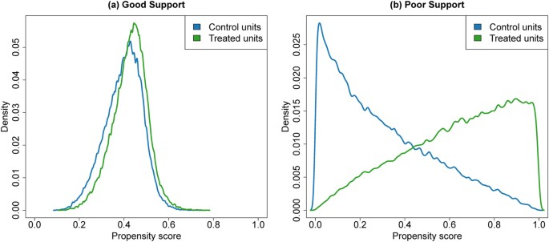
Step 1: Predict propensity scores
Model treatment (original IV) as a function of covariates:
logit(T) = β0 + βX.
Controls in X are the same as in the observational regression model.
Use the fitted model to predict propensity scores for all units.
Check overlap: Histograms of scores for treated vs. control.

Slide 14
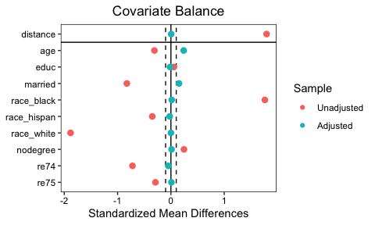
Step 2: Matching on scores
Matching methods:
Nearest neighbor (1:1 or 1:k): commonly used approach
Caliper (discard if difference > threshold): can prevent bad matches
With/without replacement:
Often with replacement if control units are limited, or hard to find matches.
Balance diagnostics: standardized mean differences (SMD < 0.1 ideal).

Slide 15
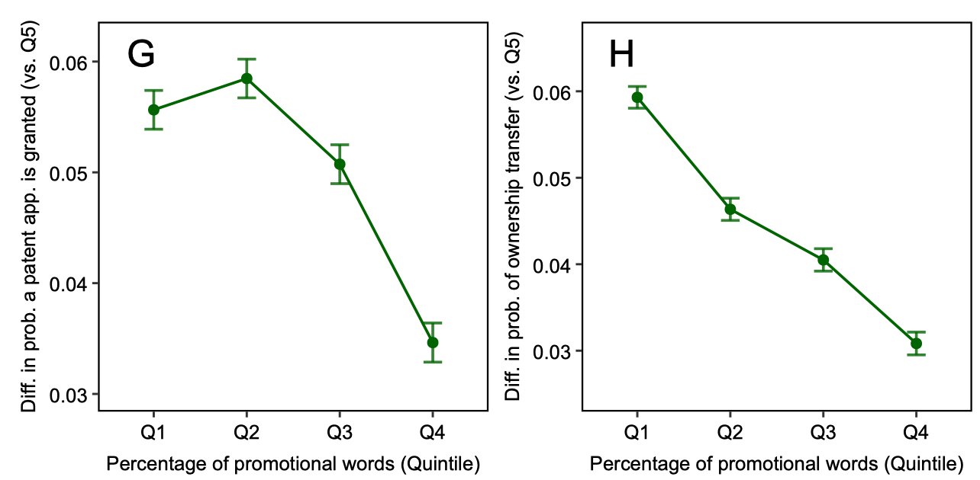
Step 3: Quantify ATE
Post-matching analysis:
Direct comparison in the mean of DV between treatment and control
Further regression analysis with control variables, on matched units
R package: MatchIt
Example: Estimating the effect of Pwords on patent success

Slide 16
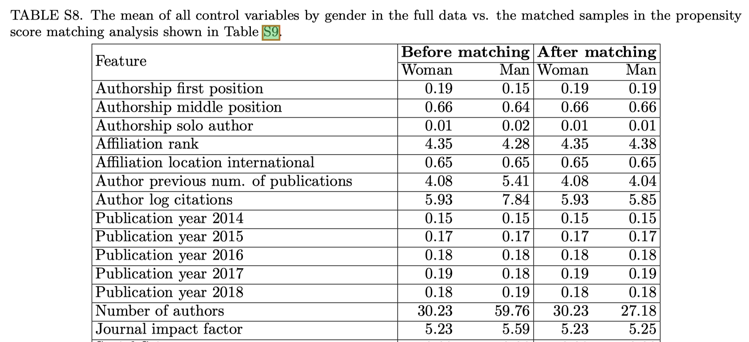
PSM in practice
Recall the observational study of the gender gap in online self-promotion.
How to use PSM for causal inference? (imbalance: more men than women)
Predict author gender (IV) using all covariates (journal, affiliation, etc.)
Matching on propensity scores. Calculate ATE by comparing diff in mean.

Slide 17
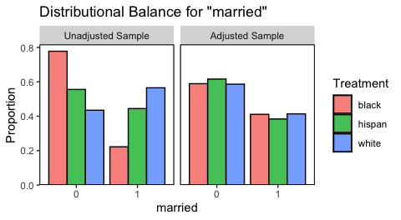
PSM (dis)advantages
Advantages:
Flexible
Can handle many covariates (unlike CEM)
Limitations:
Model misspecification bias.
Hidden bias from unobserved confounds.
Note: need to show covariate balance pre/post matching.
Notes:
The distribution of marriage is balanced across different groups after matching.

Slide 18
Difference-in-Differences (DiD)
Typically used to estimate the impact of a policy intervention or treatment (such as a passage of law or drug usage) that would take effect over time.
Key challenge: the treatment effect usually needs a clear time window to happen, but the outcome also naturally changes over time.
For example:
Treatment: minimal wage law implementation
Outcome: avg salary in a city / state
But wage naturally changes over time (inflation or unemployment crisis)

Slide 19
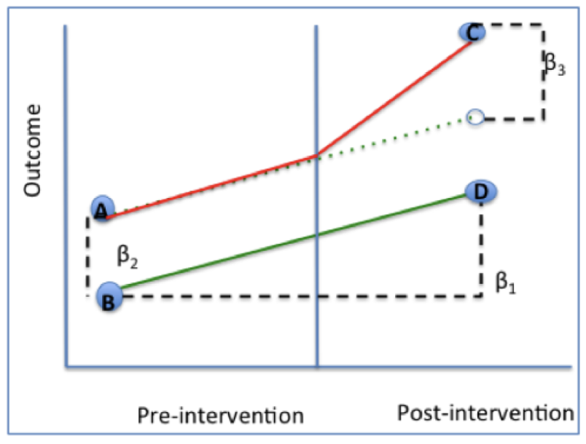
How does DiD work?
DiD estimates the ATE by comparing the change in the outcome over time between a population that is enrolled in the program/policy (intervention or treatment group) and a population that is not (control group).
Difference between two changes (a.k.a., DiD)
What is the change in outcome (wage) for treatment group (law)?
What is the ATE? What does B₂ represent?
Why is the matching /pruning unnecessary?
Notes:
Compare treated states to states without implementing the law.
B2 is the pre-treatment diff between two states
Change for treatment group: B1+ B3

Slide 20
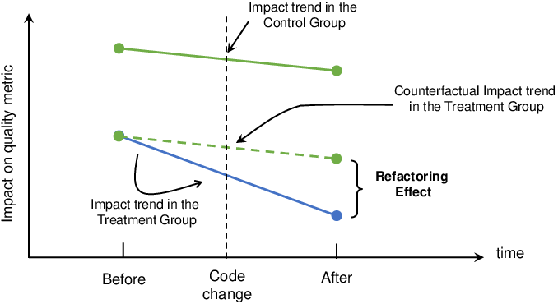
Difference-in-Differences (DiD)
Assumes parallel trends:
Without treatment, trends would be the same (diff is stable)
Common in policy evaluation
How to design the following study? (Exercise time)
Does implementing attendance check increase class attendance?
Can we just look at change in class attendance before and after?
Notes:
Treatment: classes implemented the policy in the middle of the semester
Control: classes that never implemented the policy
Attendance naturally decreases over time.

Slide 21
DiD - Basic model
Equation: Y = β0 + β1*Treat + β2*Post + β3*(Treat*Post) + X + ε
Each unit contributes two datapoints in the regression setup.
Regardless of treatment or control status
One measurement for the pre-treatment period
Another measurement for the post-treatment period
Notes: Treat=1 for treatment group, Post=1 after intervention.
β3 is the DiD estimator (the causal effect).
Add all covariates / controls in X.
What are values for these variables in the attendance study?
Notes:
Each class is an observation that contributes two datapoints in the regression.

Slide 22
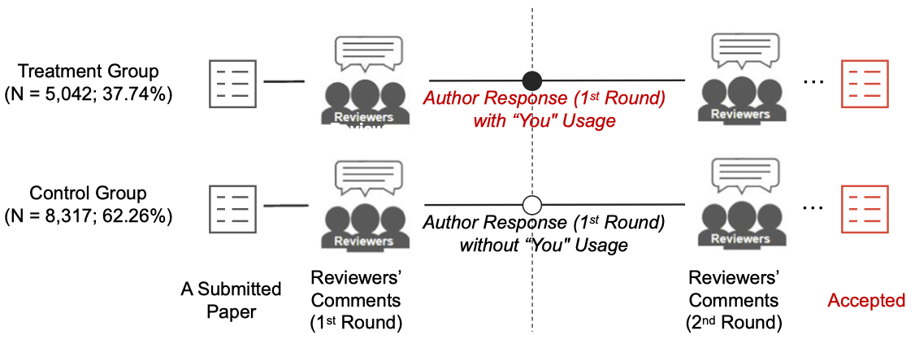
DiD in action – the effect of YOU
Does addressing reviewers with “you” lead to more positive feedback?
“Thanks for your comments.”
“Thanks for this reviewer’s comments.”
Sun et al. Nature Communications, 2025.
Notes:
Reviewer Qs naturally decrease over time.

Slide 23
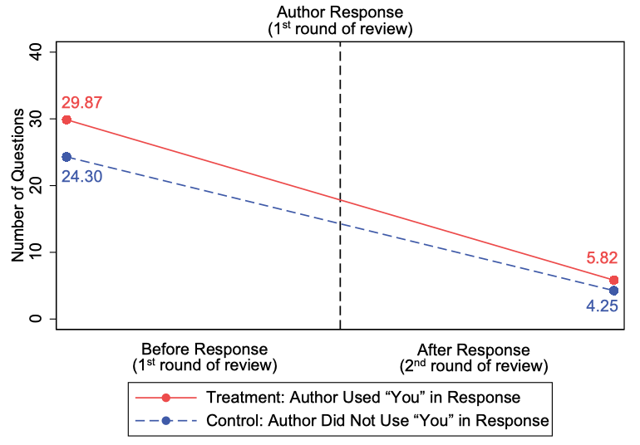
DiD in action – the effect of YOU
Does addressing reviewers with “you” lead to more positive feedback?
Papers across two groups have different numbers of issues initially.
The num. of questions naturally drops over time.
How to visualize B1, B2, and B3 in the plot?
Sun et al. Nature Communications, 2025.

Slide 24
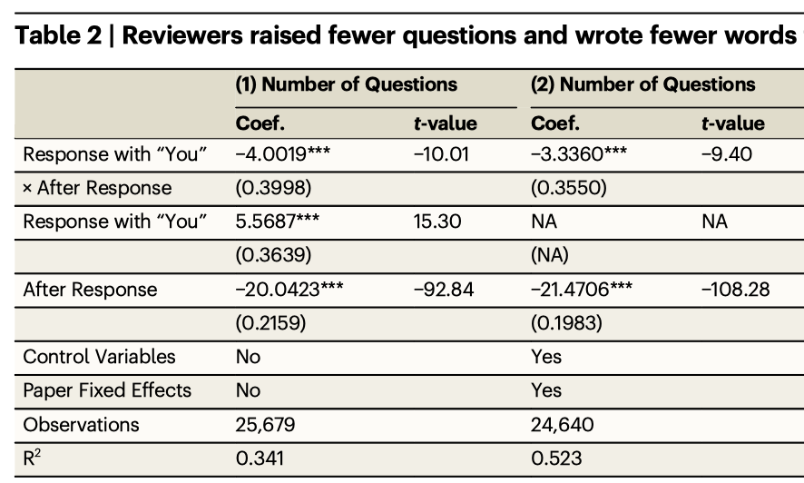
DiD in action – the effect of YOU
Does addressing reviewers with “you” lead to more positive feedback?
Sun et al. Nature Communications, 2025.

Slide 25
DiD (dis)advantages
Advantages:
Controls for selection bias: It accounts for permanent, unobserved differences between groups that might otherwise skew results in a simple one-time comparison. Because it focuses on change not the absolute level, the groups do not need to be identical at the start.
Handles external shocks: By using a control group, it cancels out the effect of "common shocks" (e.g., a nationwide economic downturn) that affect both groups simultaneously.
Limitations:
Strict parallel trends assumption: The validity rests entirely on the assumption that, without the treatment, both groups would have followed the same trend over time. This is often difficult to prove.
While it handles fixed differences, it cannot account for unobserved factors that may affect only one group (e.g., a local factory closing in just the treatment city).

Slide 26
Design exercise
Which method could be used to estimate the causal effect of AI-generated posts on user engagement metrics on RedNote?
DiD
PSM
CEM
Why?
Notes:
DiD is appropriate for cases when you can measure the outcome for the same unit at two time points.
In this case, you can’t do that for each post. So better using matching-based approaches.

Slide 27
Mediation Analysis
Mediation: examines how the treatment affects the outcome through an intermediate variable (called “mediator”).
It helps to answer "why" or "how" questions.
e.g., education → job via “skills”
WE → Paper Rating via “perceived credibility”
What factors could be considered as mediators (M)?
Hidden variables not directly observable
Decomposes total effect into direct and indirect effects.

Slide 28
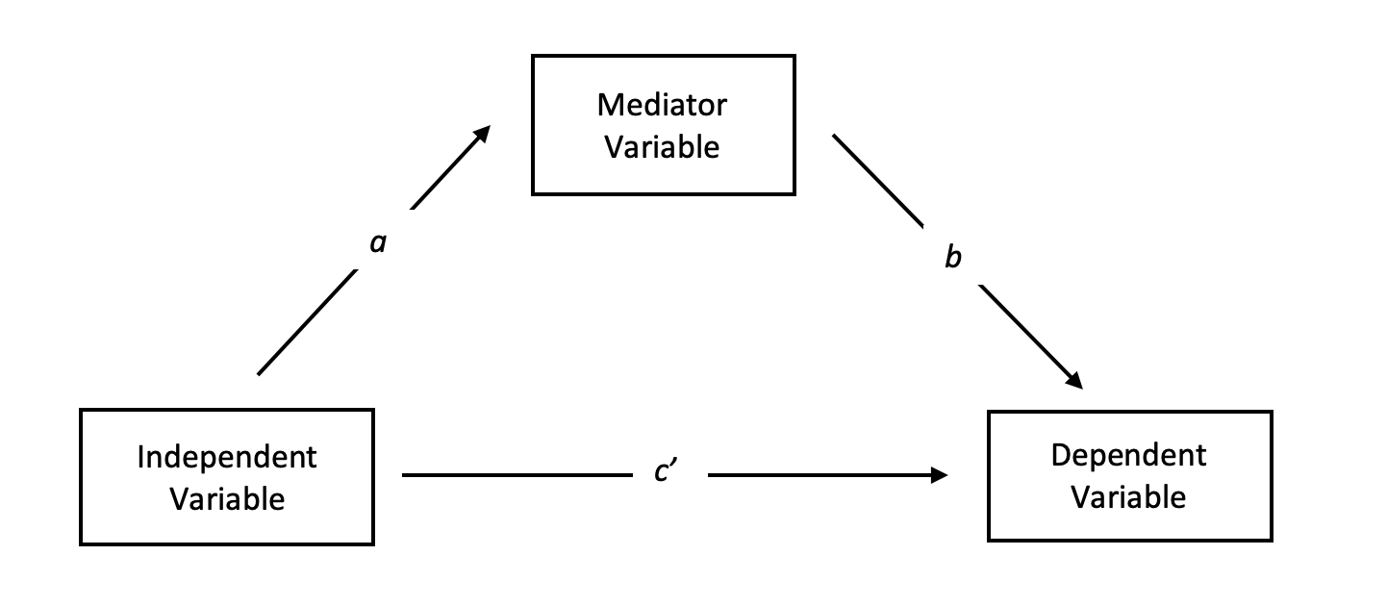
How mediation works
Step 1: X (or IV) on Y (Y = cX + e)
Step 2: X on M (M = aX + e)
Step 3: M on Y controlling for X (Y = c'X + bM + e).
Total effect = c, which can be decomposed into two parts:
Direct effect = c’ (or net effect)
Indirect effect = a*b (Product of two paths)
Add control variables in all three models.
R package: Process() or mediation()

Slide 29
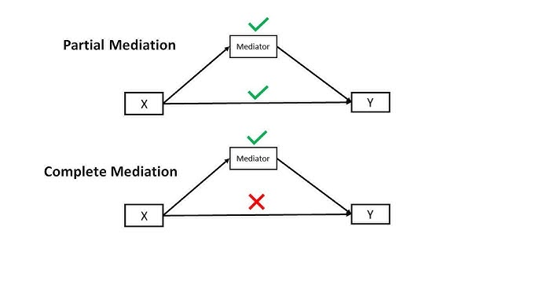
Quantifying explainability of M
A mediator may fully explain the total effect
What does the coefficient and p-value look like?
A mediator may only partly explain the total effect
How to quantify the size of its contribution?
Notes:
Indirect / total effect

Slide 30
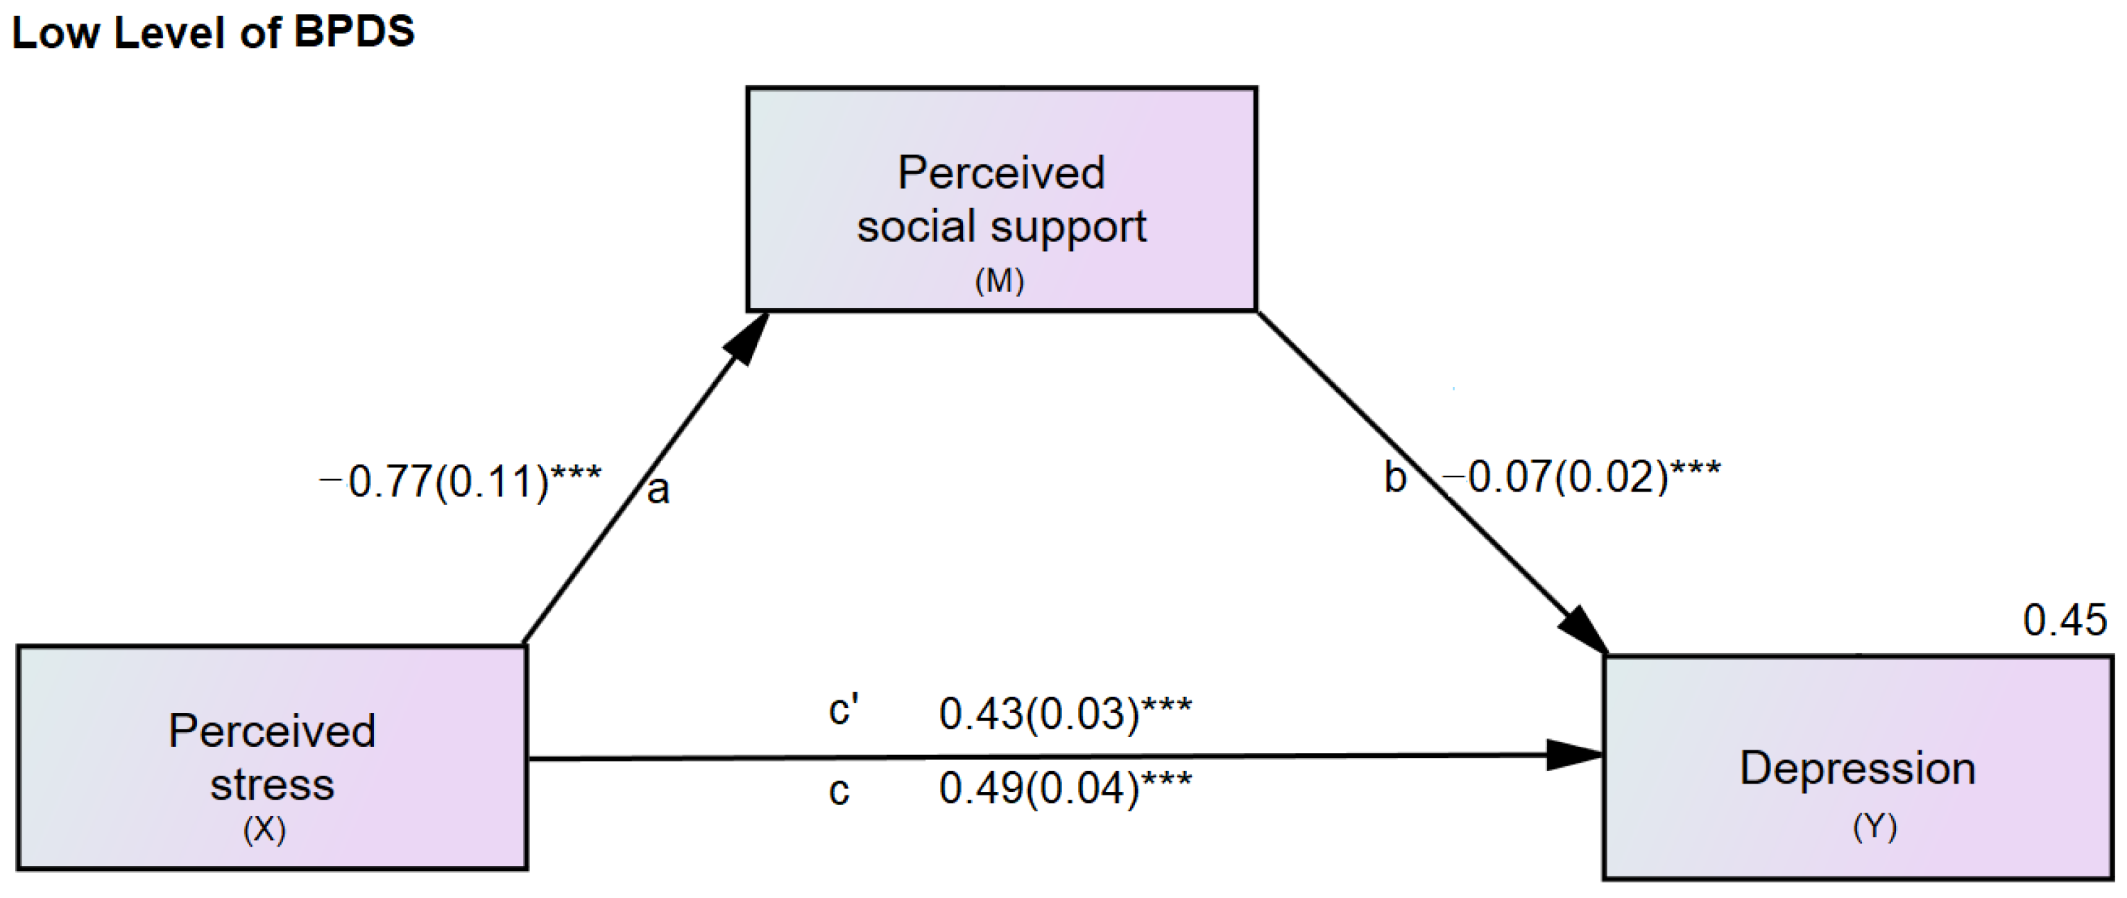
Mediation exercise 1
What are the three effect sizes?
Is the mediation effect full or partial?
What proportion of total effect can be explained by M?
What if we want to test multiple mediators at the same time?

Slide 31
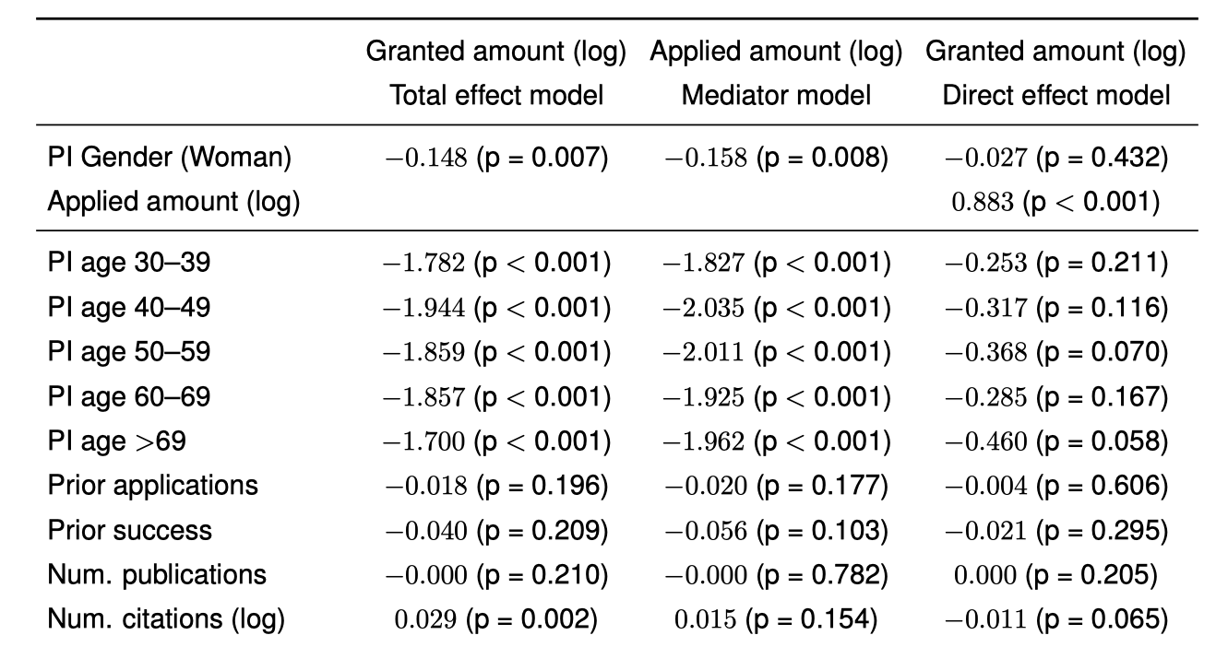
Mediation exercise 2
If we find that men PI have received larger amounts of funding than women PI in research grant applications.
What could be potential mediators? How to test it?
Plot the path diagram with coeff and p-value.

Slide 32
Summary
CEM/PSM for matching
DiD for treatment effect with a temporal change
Mediation for exploring underlying mechanisms
Applications: Policy, health, economics, etc.
Tutorial: Practice with the ICLR dataset
Causal mediation analysis of WE on perceived paper quality
LLM quality rating: Original abstracts vs. “Without-WE” replicas
LLM ratings on four psychological dimensions (mediators)
How to do parallel mediation analysis in R?

Slide 33
Course note
HW2 due on Mar 16
Print out results by executing your code
Export / submit your homework as a html file
Algorithmic society next week
Agent based modeling
Social simulation / computing
HW3 will be released next week
No free-rider for group project
Can’t replace it with an individual one
Contributions are not limited to coding: writing, presentation, etc.

